Slide 1
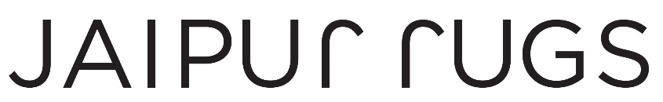
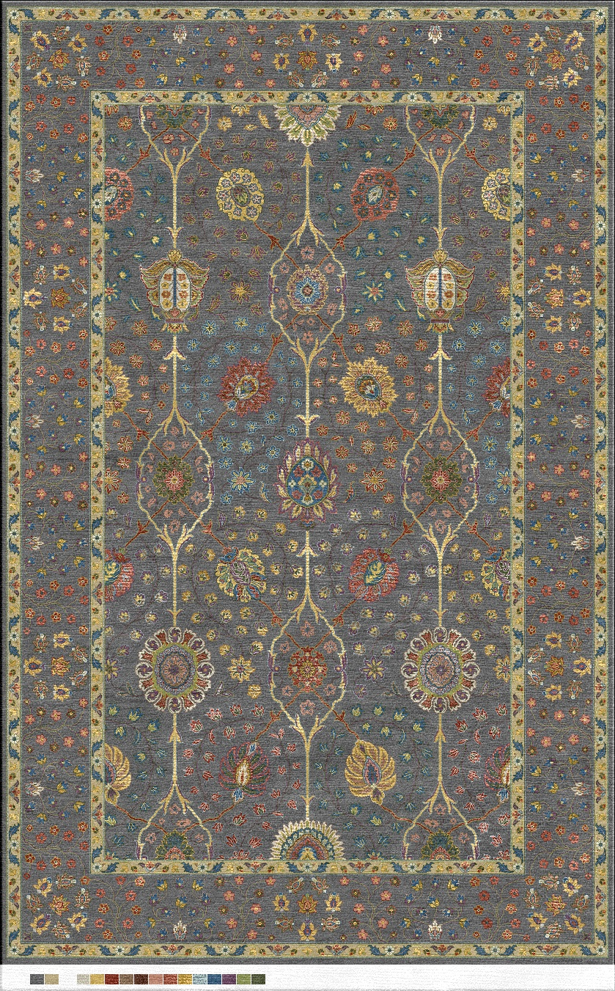
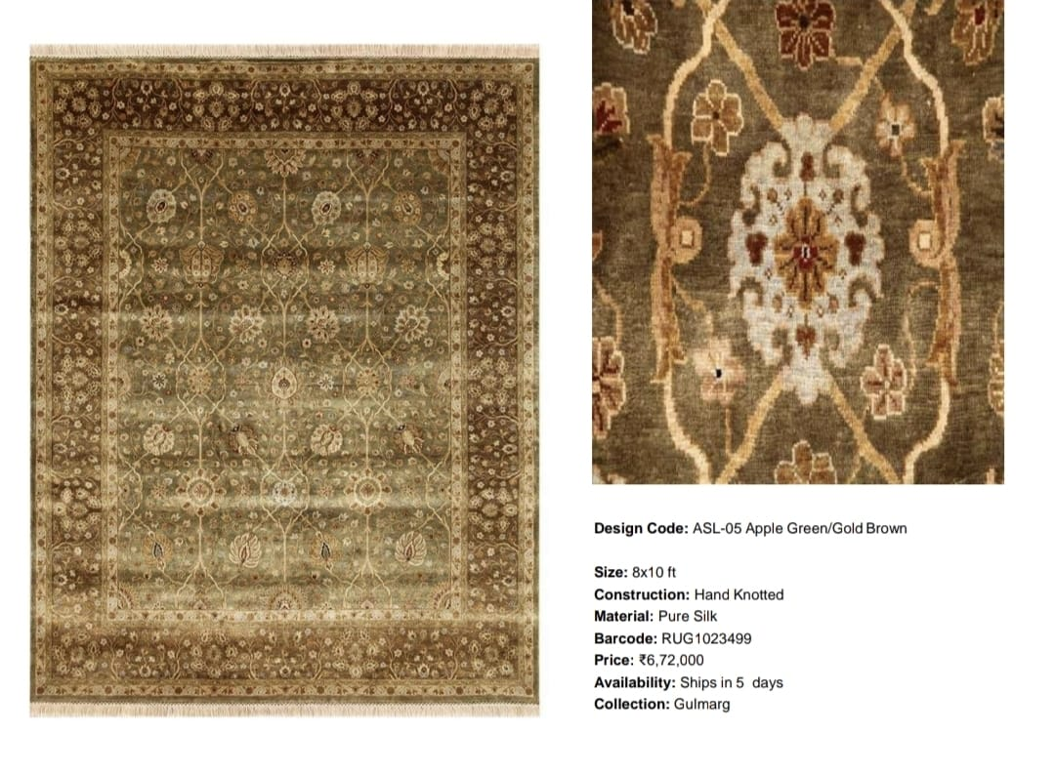
Date : 19/09/2026
Construction : Hand Knotted 14/14 MS PS
Customized Project : Divya Somani
PD-14229-ASL-05 Apple Green 0201-15 Gold Brown 0502-15-Revision
Option-1
JRC +ARS reference
^{#1. 194- Silk Cut Pile}
#2. 804^{- Silk Cut Pile}
^{#3. 911- Silk Cut Pile}
#4. 809^{- Silk Cut Pile}
^{#5. 754- Silk Cut Pile}
#6. 511^{- Silk Cut Pile}
^{#7. 510- Silk Cut Pile}
8’FEET
#8. 2652^{- Silk Cut Pile}
#9. 620^{- Silk Cut Pile}
^{#10. 607- Silk Cut Pile}
#11. 1112^{- Silk Cut Pile}
#12. 2173- ^{Silk Cut Pile}
#13. 622^{- Silk Cut Pile}
^{#14. 202- Silk Cut Pile}
#15. 315^{- Silk Cut Pile}
Pile height –7 MM -8 MM
5’FEET
^{SIZE}
^{CUSTOMER METRICS}
^{SHAPE}
^{RUG QUALITY}
^{FIBRE CONTENT}
^{DYEING TECHNIQUE}
^{FINISH EDGE}
^{FINISH PILE HEIGHT}
^{FINISH PILE TYPE}
^{FINISH BACKING}
^{FINISH WASH}
^{: 5’FEET X 8’FEET}
^{: FEET}
^{: RCT}
^{: Hand Knotted 14/14 MS PS}
^{: Silk}
^{: Standard}
^{: 4 side binding}
^{: Standard}
^{: Cut Pile}
^{: NO Backing}
^{: Standard}
Rug Image / Design Intent
45 CMS
45 CMS
IMPORTANT: Jaipur Rugs renderings are provided to illustrate pattern and color placement only. Color should be evaluated using actual yarn samples, as digital renderings cannot accurately represent final dyed yarns or handmade production variations.
Approval Box :-
Signature : ________________________________________________
Date of Approval :_________________________________________

Slide 2
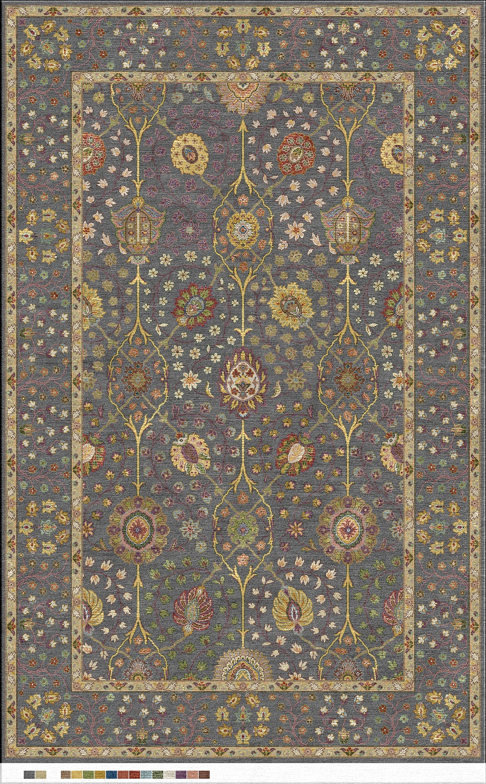
Date : 19/09/2026
Construction : Hand Knotted 14/14 MS PS
Customized Project : Divya Somani
PD-14229-ASL-05 Apple Green 0201-15 Gold Brown 0502-15-Revision
Option-2
JRC +ARS reference
^{#1. 194- Silk Cut Pile}
#2. 804^{- Silk Cut Pile}
^{#3. 911- Silk Cut Pile}
#4. 809^{- Silk Cut Pile}
^{#5. 754- Silk Cut Pile}
#6. 511^{- Silk Cut Pile}
^{#7. 510- Silk Cut Pile}
8’FEET
#8. 2652^{- Silk Cut Pile}
#9. 620^{- Silk Cut Pile}
^{#10. 607- Silk Cut Pile}
#11. 1112^{- Silk Cut Pile}
#12. 2173- ^{Silk Cut Pile}
#13. 622^{- Silk Cut Pile}
^{#14. 202- Silk Cut Pile}
#15. 315^{- Silk Cut Pile}
Pile height –7 MM -8 MM
5’FEET
^{SIZE}
^{CUSTOMER METRICS}
^{SHAPE}
^{RUG QUALITY}
^{FIBRE CONTENT}
^{DYEING TECHNIQUE}
^{FINISH EDGE}
^{FINISH PILE HEIGHT}
^{FINISH PILE TYPE}
^{FINISH BACKING}
^{FINISH WASH}
^{: 5’FEET X 8’FEET}
^{: FEET}
^{: RCT}
^{: Hand Knotted 14/14 MS PS}
^{: Silk}
^{: Standard}
^{: 4 side binding}
^{: Standard}
^{: Cut Pile}
^{: NO Backing}
^{: Standard}
Rug Image / Design Intent
45 CMS
45 CMS
IMPORTANT: Jaipur Rugs renderings are provided to illustrate pattern and color placement only. Color should be evaluated using actual yarn samples, as digital renderings cannot accurately represent final dyed yarns or handmade production variations.
Approval Box :-
Signature : ________________________________________________
Date of Approval :_________________________________________

Slide 3
INFO SECTION
Customized Project
A custom rug is by nature a unique product.
Slight variations in color and size are normal.
Please note: all custom rugs can have a variance of +/- 3 inches.
No changes once order is placed.
No cancellations once items are in production.
You may cancel your custom rug order within 5 business days from the date of the order without penalty. If you wish to cancel standard customs after 5 business days, your deposit will be forfeited.
No returns/refunds of Custom Rug.
Size limitations vary between collections.
Production times are an estimate. All efforts will be made to produce in the time quoted.
Final delivery of your custom rug will vary based on size, construction and shipping method.
Signature : ____________________
Date of Approval :_____________

